Slide 1
Chapter 7
Motor Control and Movement

Slide 2
Motor control
Functional segregation
Different areas control different aspects of movement
Hierarchical organization
Higher levels concerned with global tasks
Lower level tasks are carried out by the lower levels of the hierarchy
Four levels
the spinal cord
the brain stem
the motor cortex
the association cortex

Slide 3
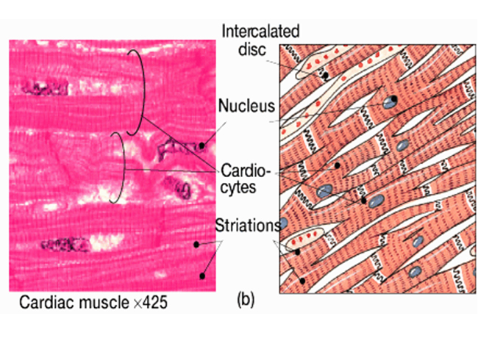
Types of muscle
Cardiac muscle
Heart
Circulates blood, maintains blood pressure

Slide 4
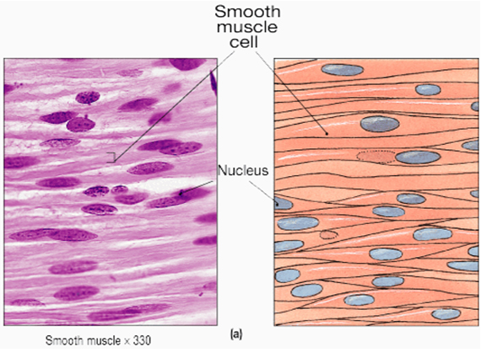
Types of muscle
Smooth muscle
Encircles blood vessels
Walls of digestive, respiratory, urinary organs
Moves food/urine products and controls blood flow

Slide 5
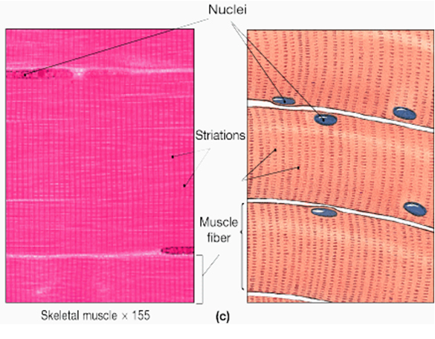
Types of muscle
Skeletal or striated muscle
Attached to bones by tendons
Moves or stabilizes movement

Slide 6
The anatomy of a muscle
Muscle fibres
Myofibrils (10-100 microns in diameter)
Myofilaments (myosin and actin)
Sarcomeres – functional units
Bands of myofilaments that overlap

Slide 7
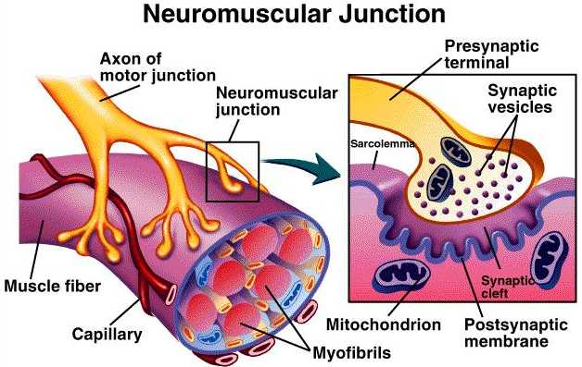
Neural control of muscle contraction
Alpha motor neurons – large axons
Extrafusal muscle fibre – predominant fibres in skeletal muscles
Motor end plate – point of innervation of extrafusal fibres
Motor unit – muscle fibres and motor neuron
Motor unit pool – groups of motor units
Neuromuscular Junction – axon terminal of a motor neuron with the muscle

Slide 8
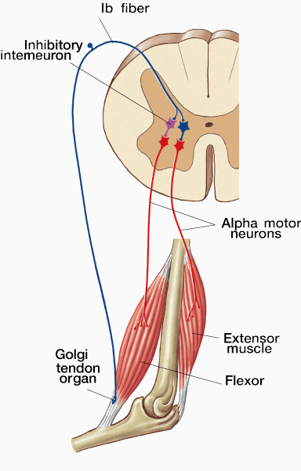
Tendon organs
Receptors located in the tendons
Detect excessive force and inhibit contraction
Prevent injury to tendon or muscle

Slide 9
Muscle spindles
Mechanoreceptors that are located inside extrafusal muscle fibres
Dynamic and static changes in muscle length
Stretching of the intrafusal muscle, triggering the annulospiral nerve endings to fire more rapidly

Slide 10
Monosynaptic stretch reflexes
Single synapse between the sensory receptor and the muscle effectors
Knee Jerk is one example
Stretch reflex also plays a major role in posture

Slide 11
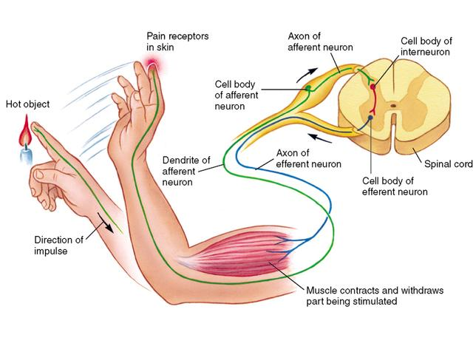
Polysynaptic stretch reflex
Withdrawal reflex
Receptor transmits signal to spinal cord and synapses on interneuron
Interneurons may excite and/or inhibit to achieve a withdrawal reflex

Slide 12
Renshaw cells
Every alpha motor neuron has a contralateral branch in the spinal cord that synapses with a Renshaw cell
Prevent muscle damage as a result of fatigue
Fires at the rate of the alpha neuron
When threshold is reached, the alpha motor neuron will stop firing
Negative feedback loop

Slide 13
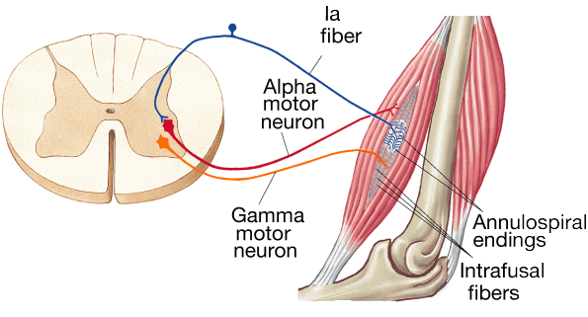
Gamma motor system
Small motor neurons originating in the spinal cord
Innervate the distal ends of the extrafusal fibres
Contraction activates the stretch reflex
Resulting is increased muscle tone
Except when we are experiencing REM sleep

Slide 14
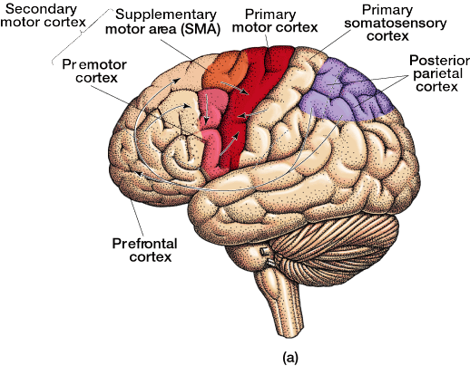
Cortical control of movement
Right hemisphere of the brain controls the left side of the body and the left hemisphere controls the right side
Primary motor cortex
Precentral gyrus
Control of voluntary movements
Layer V (large pyramidal cell layer) most distinct

Slide 15
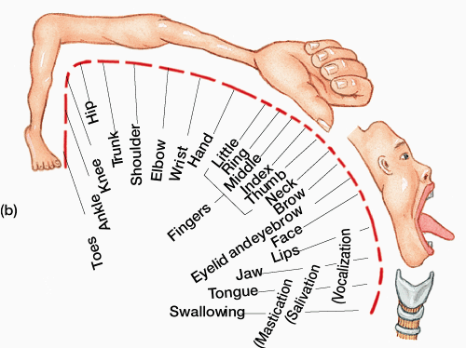
Cortical control of movement
Primary motor cortex – each part of the body has its own representation in the primary motor cortex, which is arranged somatotopically

Slide 16
Motor cortex – secondary
Consists of the premotor cortex and the supplementary motor area (SMA)
Receives input from dorsal lateral prefrontal cortex and are involved with the preparation and the sequencing of voluntary movements
Premotor cortex – mirror neurons

Slide 17
Posterior parietal cortex
Consolidates visual, auditory and skin sense information
Transmits it to the dorsal lateral prefrontal cortex
Direct movements
Neglect

Slide 18
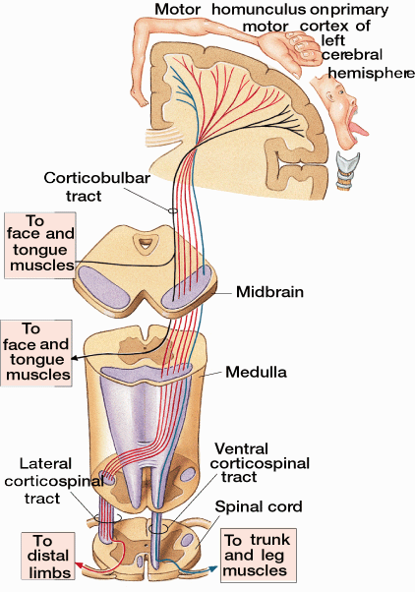
Motor tracts – originating in cortex
Corticospinal tract
Lateral corticospinal tract – fingers, hands, arms, lower leg and feet
Ventral corticospinal tract – trunk and upper legs
Corticobulbar tract – face and tongue

Slide 19
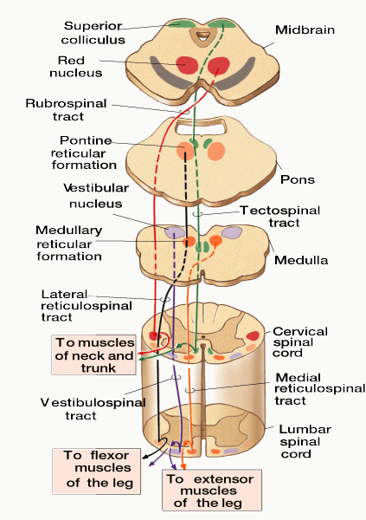
Motor tracts – originating in the sub-cortex
Ventromedial tracts
Vestibulospinal tract – leg and lower trunk movement – control of posture
Tectospinal tract – head and neck – visual tracking
Lateral reticulospinal tract – flexor muscles of the legs
Medial reticulospinal tract – extensor muscles of the legs
Rubrospinal tract – hands, lower arms, lower legs and feet

Slide 20
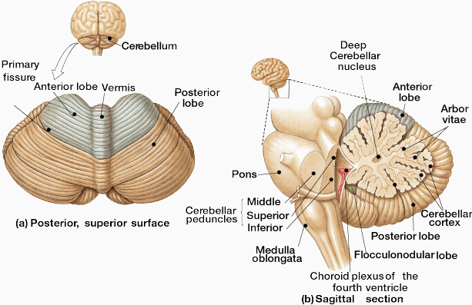
Cerebellum
Essential for coordinated movements
Integrates sensory & basal ganglia information

Slide 21
Cerebellum circuits
Input to cerebellum
Climbing fibres
Mossy fibres
Output from cerebellum
Purkinje cells
Basket cells – inhibitory control

Slide 22
Effects of damage to cerebellum
Low muscle tone
Difficulty with rapid movements, e.g. speaking, writing, typing
Dysdiadochokinesia – inability to perform rapid alternating movements, e.g. clapping hands
Difficulty controlling saccades – ballistic eye movements from one fixation point to another
Poor on finger-to-nose test
Notes:
Damage to different areas of the cerebellum has different effects. Patients with cerebellar damage demonstrate one or more of the symptoms of low muscle tone, jerky movements, incoordination (especially when standing, walking, speaking or performing precise aiming movements), poor temporal control of muscle recruitment and difficulty learning new movements or adapting old ones. Fast, ballistic types of movement are particularly affected.

Slide 23
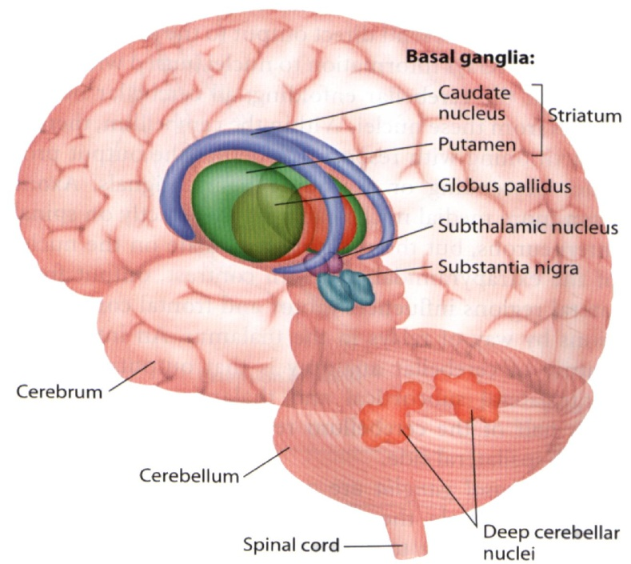
Basal ganglia
Integrates movement & control of posture
Striatum
Caudate nucleus
Putamen
Nucleus Accumbens
Globus Pallidus
Internal segment
External segment
Subthalamic nucleus
Substantia nigra
Pars compacta
Pars reticulata

Slide 24
Parkinson’s disease
Slow movements, difficulty initiating movements, muscle rigidity, tremor
Degeneration of path of dopamine- containing axons from substantia nigra to caudate nucleus and putamen
Treatment with L-DOPA, precursor to dopamine
Notes:
Degenerative disease resulting in deficiency in the natural neurotransmitter substance, dopamine, which assists in carrying nerve impulses from one nuclei in the basal ganglia to another.
Patients have a range of motor symptoms including slow movements, shuffling, uncertain gait, high degrees of rigidity or muscle stiffness and limb tremor. Also have difficulty initiating movements, so may have trouble standing up or starting to walk. Once they start they can continue.
Range of other treatments include putting in wires to stimulate the sub-thalamic nucleus.

Slide 25
Types of muscle

Slide 26
Cortical areas

Slide 27
Motor pathways

Slide 28
Cerebellum

Slide 29
Basal ganglia

Slide 30
Motor systems

Slide 31
Readings
Barnes, J. (2011). Essential Biological Psychology (Chapter 7). London: Sage.
The Essentials
Haaland, K.Y., Harrington, D.L., & Knight, R.T. (2000) Neural representations of skilled movement. Brain, 123, 2306–2313.
Next Steps
Rizzolatti, G., & Craighero, L. (2004). The mirror-neuron system.
Annual Review of Neuroscience, 27, 169–192.
Delving Deeper
Wilson, P.H., & McKenzie, B.E. (1998). Information processing deficits associated with developmental coordination disorder: a meta-analysis of research findings. Journal of Child Psychology & Psychiatry, 39(6), 829-840.

